Slide 1
LQR

Slide 2
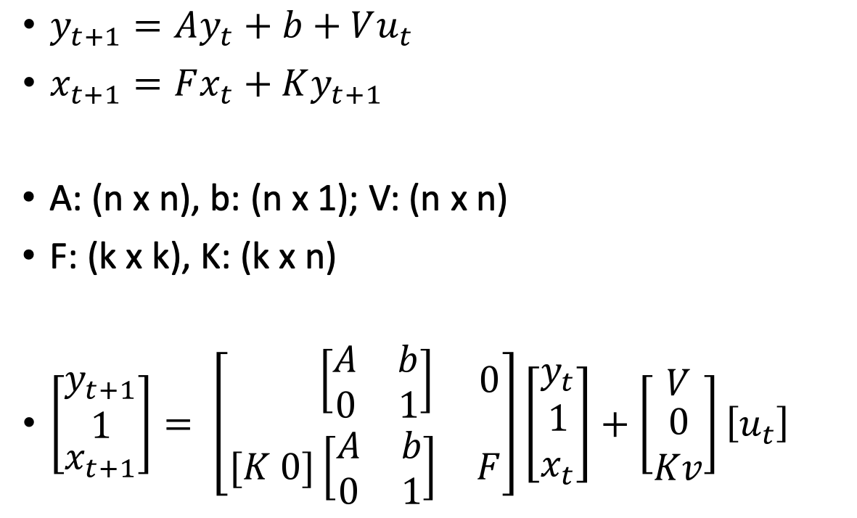
Equations
$y_{t+1}=Ay_{t}+b+Vu_{t}$
$x_{t+1}=Fx_{t}+Ky_{t+1}$
A: (n x n), b: (n x 1); V: (n x n)
F: (k x k), K: (k x n)
$\left[\begin{matrix}\begin{matrix}y_{t+1} \\ 1\end{matrix} \\ x_{t+1}\end{matrix}\right]= \left[\begin{matrix} \left[\begin{matrix}A & b \\ 0 & 1\end{matrix}\right] & 0 \\ [K 0]\left[\begin{matrix}A & b \\ 0 & 1\end{matrix}\right] & F\end{matrix}\right]\left[\begin{matrix}y_{t} \\ 1 \\ x_{t}\end{matrix}\right]+\left[\begin{matrix}V \\ \begin{aligned}0 \\ Kv\end{aligned}\end{matrix}\right]\left[u_{t}\right]$
Neural
Cursor
(n + 1)
k
(n
+
1)
(n
+
1)
n
(n
+
1)
(n)
(1)
(k)
1
(n + 1)
n
(n + 1)
k
(n
+
1)
k
k
k
k

Slide 3
Toy example
Cursor pos y
2 neurons
5 state cursor (x/y pos/vel + offset)
A = 2D rotation matrix; 1 hz + slight decay
b= [0, 0];
Cursor pos x
Blue + purple “fight”
Dynamics so higher
Energy for the “turn”
Neuron 2
U
Neuron 1

Slide 4
Thoughts;
Seeking evidence that having an offset actually matters to how LQR computes “optimal” trajectory;

Slide 5
Behavior + Neural
2 hz
R = 1,000,000
2 neurons
Offset is zero

Slide 6

Slight difference!
2 hz
R = 1,000,000
2 neurons
Offset is NON-zero (=1)

Slide 7
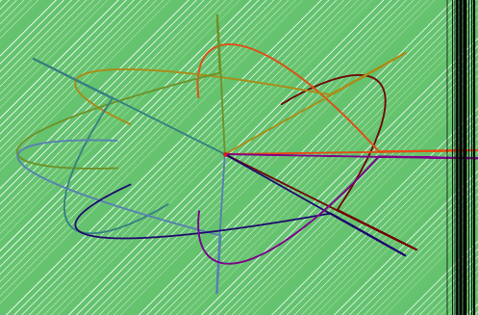
Looking for same effect w/ decaying dynamics
No offset
Offset = 1
Offset = 2

Slide 8
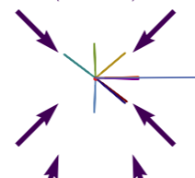
No effect for decaying dynamics...
Another issue
High R and quickly decaying dynamnics prevent controller from “fighting” – incomplete trials
R = 1,000,000

Slide 9
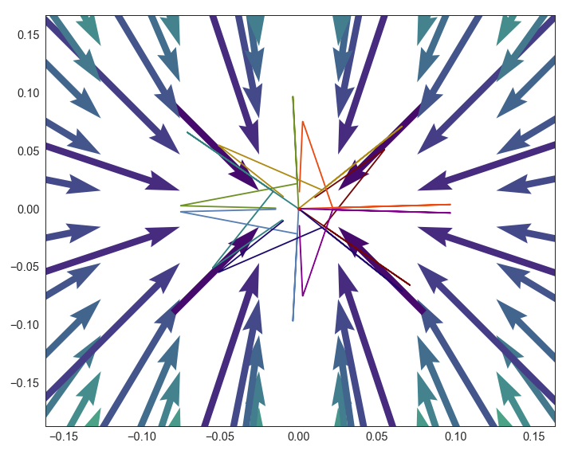
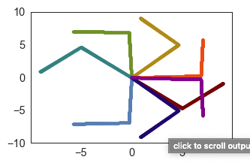
Reducing R = 10,000 for decay ~= 0.1, zero offset;

Slide 10
Evidence of offset affecting trajectories;
Added offset;

Slide 11
Ok, so getting this to work is an art of finding the right R
Right R makes the thing sensitive to offsets;
Too high, can’t do task
Too low, doesn’t matter where the offset is;
Also right R makes it such that dynamics matter more;

Slide 12
Examples in Grom data;
Left = CO, Right = OBS
Red plot = day 0, orange plot = day 1
Cases where total effort is high (orange), shuffle is much more effort than the obstacle i.e. borderline breaking;

Slide 13
More examples;

Slide 14
Ok so for a given day what makes “R” high?
Number of cells?
Offset ?
Decoder alignment with the offset?
Eigenvalues?

Slide 15
E.g. by Adusting R → making higher (R=40);
True Data
Shuffled Data

Slide 16
If R is too long though, early activations in the beginning cost;
Maybe some targets just require lower activation through the decoder?
Maybe we need to make it so that the neural data is trying to approach
a point with zero output through the decoder; Also make that the reset point

Slide 17
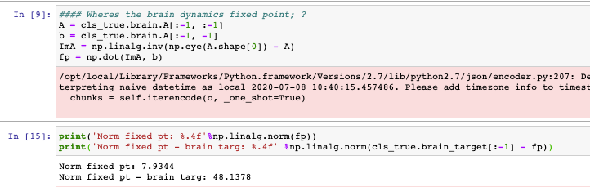
Consider adding a “brain target”
E(n_t | a_t = 0)
Use the same conditioning approach to estimate this value;
Perhaps will give advantage to actual neural dynamics, since dynamics support activity around this offset ;
Another concern – Brain offset was ”costing”
Implemented these changes – doesn’t seem to matter;
Maybe this brain cost is as far from the fixed point as the zero point?

Slide 18
Eigenvalues of task-demean (fit with no intercept)
Really fast decaying dynamics around the mean;

Slide 19
Thoughts
Why might offs = 0, dyn = 0 be BETTER than real dynamics?
Because the offset doesn’t have a potent readout that the controller has to deal with and account for K(0) = 0, where K(fixed pt) =/= 0 always;
Try LQR with true shuffled data
Try with offset and no A; ?
Within minimal R can seem tiny effect;
Resetting to zero
Comparing to zero’d out A with offset;
Ideally compare actual shuffle coefficients;

Slide 20
Shuffle (x=0) vs. data (x=1)
Shuffle same offset,
Top = Mean U
Bottom = Total U
Left = CO
Right = Obs;
Adjusted for cell number
In R input: (R_day = R*44/#cells)

Slide 21
Day-to-Day differences;
Diffs in what shuffled offset if capturing?
Red/Orange/Black days work best compared to shuffle;

Slide 22
Summary – day to day variation in whether shuffle (or fully zero’d out) model is better than true dynamics
Day to day variation in whether shuffle (or fully zero’d out) model is better than true dynamics that currently can’t explain
Maybe related to alignment of dynamics to decoder;
Maybe related to relationship b/w decoder offset and dynamics offset, though nothing obvious
Regardless – small effect size
Big Rs might help,
Some sort of R optimization;
Constraint – right now simulation doesn’t know it can’t go through the obstacle – so sometimes when R is high it tries to go through the obstacle and gets stuck; Would be nice to put some infinite cost on going throuhg the obstacle

Slide 23
Make Fig 6/7 without offset;
In the supplement show an example day that works with offset (shuff needs more u_t than data);

Slide 24
Issue – variables weren’t lining up with KG
Re-doing with correct variable ordering;
Here comparing zero A to Ridge (without offset);

